Slide 1



MISOGYNY
DETECTION
Canistro Federico 775605
De Cosmis Ivan 787066

Slide 2

Misogyny Detection
Misogyny is a rampant phenomenon in today's society, manifesting itself through hate speech and discrimination based on gender. Identifying and combating misogyny is a crucial goal in promoting gender equality and creating a safe environment for all.
Abstract
In this presentation we present different models used to approach the resolution of the proposed task, discuss the results and provide our explanations
Misogyny & Aggressive Behaviour Identification
Our task was to create two types of models:
The first one able to identify misogynistic tweets from non-misogynistic ones
The second one able to identify among misogynistic tweets those that are aggressive

Slide 3

ANALYZING THE DATASET

Slide 4
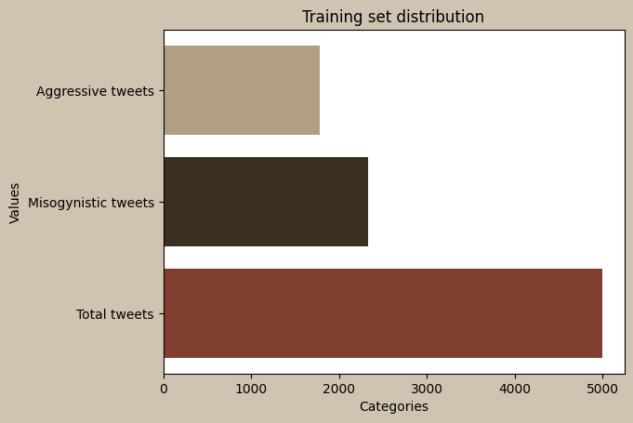
4998
TRAINING SET
Number of Italian tweets.
2337 2661
Misogynous tweets and not misogynous.
1783 3215
Misogynistic&Aggressive and misogynistic&not-Aggressive.

Slide 5
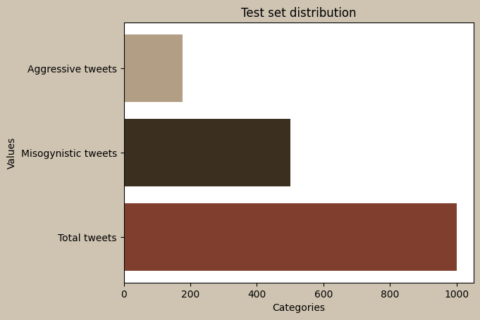
1000
TEST SET
Number of Italian tweets.
500
Misogynous tweets and not misogynous.
176 824
Misogynistic and aggressive tweets and not aggressive.

Slide 6

DATA PRE-PROCESSING

Slide 7
Removing tags and emoji
We have performed some data cleaning
on the set, removing tags and emoji
for row in reader:
modified_row = [re.sub(pattern, "",
cell) for cell in row]
writer.writerow(modified_row)
We have used regolar expressions to identify patterns in the datasets and clean them:
r”<(MENTION_\d+|URL)>\s*”
u'(' + u'|'.join(re.escape(u) for u in emojis) + u')'
for row in reader:
modified_row = [remove_emoji(cell) for
cell in row]
writer.writerow(modified_row)

Slide 8
RESULTS
PRE-CLEANING
POST-CLEANING
Tweet 0 : <MENTION_1> <MENTION_2> Fatti trovare te lo do volentieri e ti s***** in bocca
Tweet 1 : <MENTION_1> Tu dovresti ricominciare dai semafori a fare la lavavetri..ma tranquilla tanto il vitalizio ti resterà in gola
Tweet 2 : Amore,sei presentabile? Xchè così via Skype ti faccio conoscere i miei parenti..." e fu così che da un tablet...
Tweet 3 : <MENTION_1> Salvo poi mandare la culona a Mosca, aummaumm, per farsi dare da Putin...
Tweet 4 : <MENTION_1> <MENTION_2> Vediamo Gentiloni, è ora di finirla di essere...
Tweet 0 : Fatti trovare te lo do volentieri e ti s***** in bocca
Tweet 1 : Tu dovresti ricominciare dai semafori a fare la lavavetri..ma tranquilla tanto il vitalizio ti resterà in gola
Tweet 2 : Amore,sei presentabile? Xchè così via Skype ti faccio conoscere i miei parenti..." e fu così che da un tablet...
Tweet 3 : Salvo poi mandare la culona a Mosca, aummaumm, per farsi dare da Putin...
Tweet 4 : Vediamo Gentiloni, è ora di finirla di essere servili! Pensiamo al danno che la...

Slide 9

DIVIDING THE TRAINING SET AND THE TEST SET

Slide 10
MISO_SET AND AGGR_SET
train_set_miso contains all the data for the train for the task of finding misogynous tweets | test_set_miso contains all the data for the test for the task of finding misogynous tweets
train_set_aggr contains all the data for the train for the task of finding aggressive tweets among misogynistic | test_set_aggr contains all the data for the test for the task of finding aggressive tweets among misogynistic ones

Slide 11

MODEL:
RANDOM FOREST

Slide 12
WHAT, HOW, ADVANTAGES
RF is a machine learning algorithm that is used for classification and regression problems. It is based on the concept of a set of decision trees (known as a "forest") that are built randomly and then combined to get a final prediction
How the Random Forest model works:
Creation of decision trees
Feature selection
Training of decision trees
Prediction
Some of the Random Forest advantages:
Automatic handling of relevant variables
Resistance to noise and outliers
Evaluation of variable importance
Reduction of overfitting risk
How
Advantages
WHAT

Slide 13
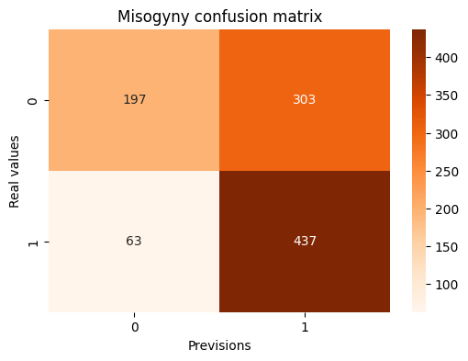
Random Forest
Misogyny Detection
We have tested the random forest applying the following nlp operation on the set:
Removing all capital letters
Removing all punctuation marks
Removing all the italian stopwords
Obtaining the following result:
F1 Score: 0.70
Class zero:
Precision: 0.76
Recall: 0.39
F1 Score: 0.52
Class one:
Precision: 0.59
Recall: 0.87
F1 Score: 0.70

Slide 14
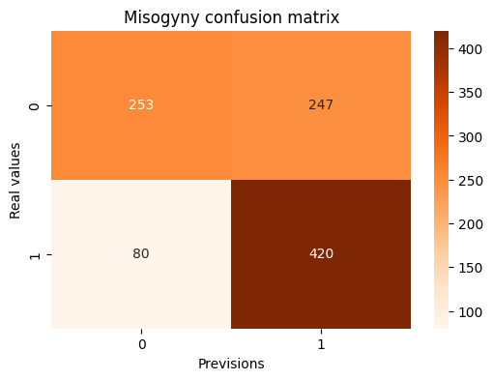
Random Forest
Misogyny Detection
We have tested the random forest applying the following nlp operation on the set:
Removing all capital letters
Removing all punctuation marks
Removing all the italian stopwords
Stemming
Obtaining the following result:
F1 Score: 0.72
Class zero:
Precision: 0.76
Recall: 0.51
F1 Score: 0.61
Class one:
Precision: 0.63
Recall: 0.84
F1 Score: 0.72

Slide 15
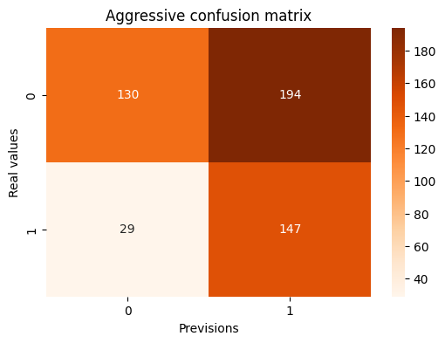
Random Forest
Aggressive Detection
We have tested the random forest applying the following nlp operation on the set:
Removing all capital letters
Removing all punctuation marks
Removing all the italian stopwords
Obtaining the following result:
F1 Score: 0.57
Class zero:
Precision: 0.82
Recall: 0.40
F1 Score: 0.54
Class one:
Precision: 0.43
Recall: 0.84
F1 Score: 0.57

Slide 16
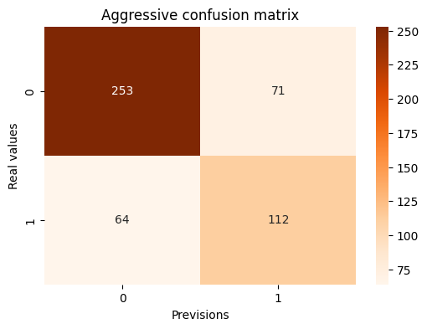
Random Forest
Aggressive Detection
We have tested the random forest applying the following nlp operation on the set:
Removing all capital letters
Removing all punctuation marks
Removing all the italian stopwords
Stemming
Obtaining the following result:
F1 Score: 0.58
Class zero:
Precision: 0.87
Recall: 0.36
F1 Score: 0.51
Class one:
Precision: 0.43
Recall: 0.90
F1 Score: 0.58

Slide 17

Random Forest
Aggressive Detection
We tried to balance the train set artificially removing 1400 samples from the aggressive data, we have used the following operations on the text:
Removing all capital letters
Removing all punctuation marks
Removing all the italian stopwords
Stemming
Obtaining the following result:
F1 Score: 0.64
Class zero:
Precision: 0.81
Recall: 0.78
F1 Score: 0.79
Class one:
Precision: 0.62
Recall: 0.66
F1 Score: 0.64

Slide 18

MODEL:
NAIVE BAYES

Slide 19
WHAT, HOW, ADVANTAGES
The Naive Bayes model is a supervised classification algorithm based on Bayes' theorem with the assumption of conditional independence between features (predictive variables). It is often used for text classification and sentiment analysis but can be applied to a wide range of classification problems.
How the Naive Bayes model works:
Bayes’ Theorem
Assumption of Conditional Independence
Model Training
Class Probability Calculation
Some of the Random Forest advantages:
Simplicity
Efficiency
Handling High-Dimensional Data
Quick Training
WHAT
Advantages
How

Slide 20
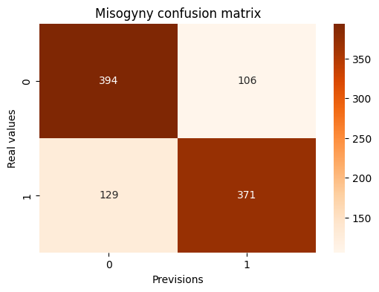
Naive Bayes
Misogyny Detection
We have tested the Naive Bayes applying the following nlp operation on the set:
Removing all capital letters
Removing all punctuation marks
Removing all the italian stopwords
Obtaining the following result:
F1 Score: 0.76
Class zero:
Precision: 0.75
Recall: 0.79
F1 Score: 0.77
Class one:
Precision: 0.78
Recall: 0.74
F1 Score: 0.76

Slide 21
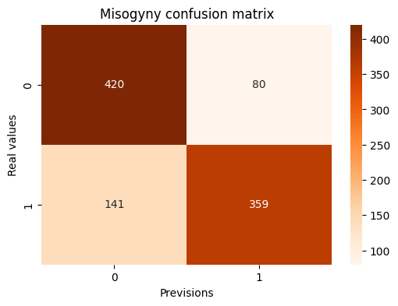
Naive Bayes
Misogyny Detection
We have tested the Naive Bayes applying the following nlp operation on the set:
Removing all capital letters
Removing all punctuation marks
Removing all the italian stopwords
Stemming
Obtaining the following result:
F1 Score: 0.76
Class zero:
Precision: 0.75
Recall: 0.84
F1 Score: 0.79
Class one:
Precision: 0.82
Recall: 0.72
F1 Score: 0.76

Slide 22
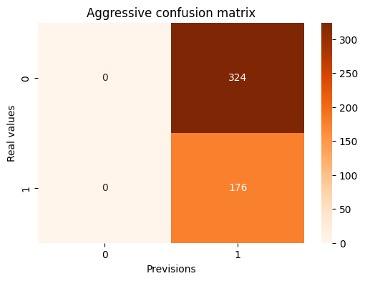
Naive Bayes
Aggressive Detection
We have tested the Naive Bayes applying the following nlp operation on the set:
Removing all capital letters
Removing all punctuation marks
Removing all the italian stopwords
Stemming
Obtaining the following result:
F1 Score: 0.52
Class zero:
Precision: 0.00
Recall: 0.00
F1 Score: 0.00
Class one:
Precision: 0.35
Recall: 1.00
F1 Score: 0.52

Slide 23
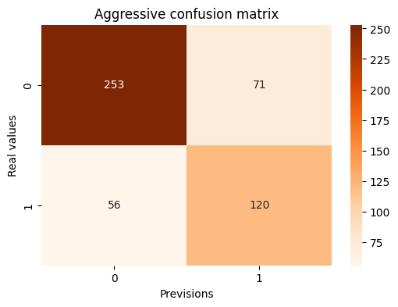
Naive Bayes
Aggressive Detection
Again we did the same operations as we did for the Random Forest, rebalancing the set removing 1400 samples and using the following nlp operations:
Removing all capital letters
Removing all punctuation marks
Removing all the italian stopwords
Stemming
Obtaining the following result:
F1 Score: 0.65
Class zero:
Precision: 0.82
Recall: 0.78
F1 Score: 0.80
Class one:
Precision: 0.63
Recall: 0.68
F1 Score: 0.65

Slide 24
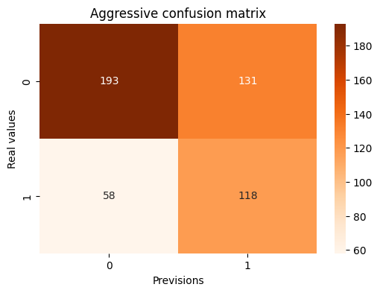
Naive Bayes
Aggressive Detection
We tried a different approach pumping the number of samples using WordNet and synonyms, we have added 6500 new tweets and we have used the following nlp operations:
Removing all capital letters
Removing all punctuation marks
Removing all the italian stopwords
Stemming
Obtaining the following result:
F1 Score: 0.55
Class zero:
Precision: 0.77
Recall: 0.60
F1 Score: 0.67
Class one:
Precision: 0.47
Recall: 0.67
F1 Score: 0.56

Slide 25

MODEL:
Neural Network LSTM

Slide 26
WHAT, HOW, ADVANTAGES
LSTM is a type of recurrent neural network (RNN) architecture that is designed to handle sequential data, such as time series or natural language data, by capturing long-term dependencies.
How the Naive Bayes model works:
Input Sequence
LSTM cells
Gating mechanisms
Memory cell
Hidden state
Some of the Random Forest advantages:
Capturing long term-dependencies
Handling variable-length sequences
Versatility across domains
WHAT
Advantages
How

Slide 27
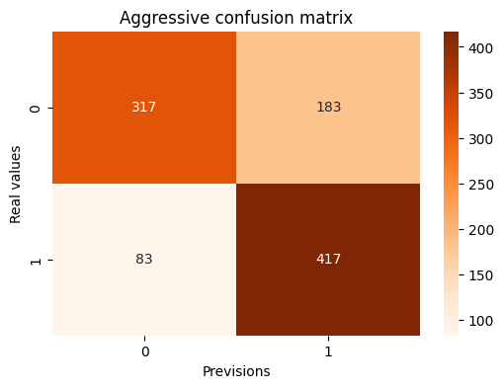
LSTM
Misogyny Detection
We have tested the LSTM applying the following nlp operation on the set:
Setting a maximum length for each tweet of 40 words
Obtaining the following result:
F1 Score: 0.76
Class zero:
Precision: 0.79
Recall: 0.63
F1 Score: 0.70
Class one:
Precision: 0.69
Recall: 0.83
F1 Score: 0.76

Slide 28
LSTM
Aggressive Detection
We have tested the LSTM applying the following nlp operation on the set:
Setting a maximum length for each tweet of 40 words
Obtaining the following result:
F1 Score: 0.52
Class zero:
Precision: 0
Recall: 0
F1 Score: 0
Class one:
Precision: 0.35
Recall: 1.00
F1 Score: 0.52

Slide 29
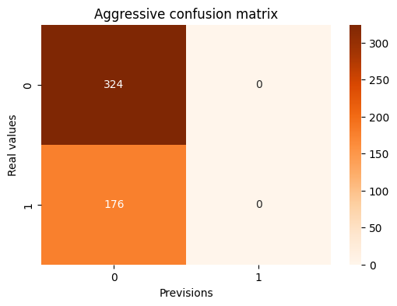
LSTM
Aggressive Detection
We have tested the LSTM applying the following nlp operation on the set:
Setting a maximum length for each tweet of 40 words
Reducing the number of positive samples by 1400
Obtaining the following result:
F1 Score: 0.00
Class zero:
Precision: 0.65
Recall: 1.00
F1 Score: 0.79
Class one:
Precision: 0.00
Recall: 0.00
F1 Score: 0.00

Slide 30
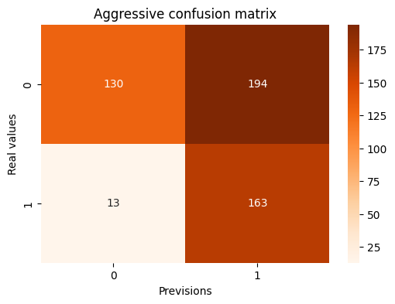
LSTM
Aggressive Detection
We have tested the LSTM applying the following nlp operation on the set:
Setting a maximum length for each tweet of 40 words
Pumping 6000 new tweets in the negative samples using WordNet and synonyms
Obtaining the following result:
F1 Score: 0.61
Class zero:
Precision: 0.91
Recall: 0.40
F1 Score: 0.56
Class one:
Precision: 0.46
Recall: 0.93
F1 Score: 0.61

Slide 31

RESULTS

Slide 32
Model | Detection | Stemming | Data Augmentation | F1 Score
Random Forest | Misogyny | No | No | 0.70
Random Forest | Misogyny | Yes | No | 0.72
Random Forest | Aggressive | No | No | 0.57
Random Forest | Aggressive | Yes | Yes | 0.64
Random Forest | X | X | X | X
Naive Bayes | Misogyny | No | No | 0.75
Naive Bayes | Misogyny | Yes | No | 0.76
Naive Bayes | Aggressive | No | No | 0.52
Naive Bayes | Aggressive | Yes | Yes | 0.65
Naive Bayes | Aggressive | Yes | Yes | 0.55
LSTM | Misogyny | No | No | 0.76
LSTM | Aggressive | No | No | 0.52
LSTM | Aggressive | No | Yes | 0.00
LSTM | Aggressive | No | Yes | 0.61
Models
Results
AMI Baseline
Rank | Run Type | Score | Team
1 | u | 0.882 | jigsaw
2 | c | 0.818 | PoliTeam
3 | c | 0.814 | PoliTeam
4 | c | 0.705 | fabsam
5 | c | 0.702 | fabsam
6 | c | 0.694 | PoliTeam
7 | c | 0.691 | fabsam
8 | u | 0.649 | jigsaw
9 | c | 0.613 | MDD
10 | c | Yes | AMI_BASELINE
Model | Score A
Naive Bayes | 0.705
Random Forest | 0.68
LSTM | 0.68

Slide 33
THANK YOU!
We hope that the presentation was clear and interesting!

Slide 34

2 out of 5
Elaborate on the featured statistic.
95%
Elaborate on the featured statistic.
12 million
Elaborate on the featured statistic.

Slide 35


ADD A SECTION HEADER

Slide 36
PRETITLE
TITLE
Paragraph 1 Present with ease and wow any audience with Canva Presentations. Choose from over a thousand professionally-made templates to fit any objective or topic. Make it your own by customizing it with text and photos.
SUBTITLE
HEADING 1
HEADING 2
Paragraph 2 Present with ease and wow any audience with Canva Presentations. Choose from over a thousand professionally-made templates to fit any objective or topic. Make it your own by customizing it with text and photos.
HEADING 3
HEADING 4
HEADING 5
HEADING 6
FOOTER

Slide 37

HOW TO USE
THIS PRESENTATION
Click on the "Google Slides" button below this presentation preview.
Click on "Make a copy."
Start editing your presentation.
You need to sign in to your Google account.
Click on the "PowerPoint" button below this presentation preview.
Start editing your presentation.
Download and install the fonts used in this presentation as listed on the next page.
Click on the "Canva" button under this presentation preview.
Start editing your presentation.
You need to sign in to your Canva account.
CANVA
GOOGLE SLIDES
POWERPOINT

Slide 38

Misogyny Detection
This presentation template uses the following free fonts:
Titles: Montserrat
Headers: Cabin Regular
Body Copy: Cabin Regular
You can find these fonts online too.
Happy designing!

Slide 39

Write an agenda here.
ADD AN
AGENDA PAGE
Write an agenda here.
Write an agenda here.
Write an agenda here.
Write an agenda here.

Slide 40

WRITE YOUR TOPIC OR IDEA
ADD A MAIN POINT
ADD A MAIN POINT
ADD A MAIN POINT
Briefly elaborate on what you want to discuss.
Briefly elaborate on what you want to discuss.
Briefly elaborate on what you want to discuss.

Slide 41



I'm Rain, and I'll be sharing with you my beautiful ideas. Follow me at @reallygreatsite to learn more.
HELLO THERE!

Slide 42

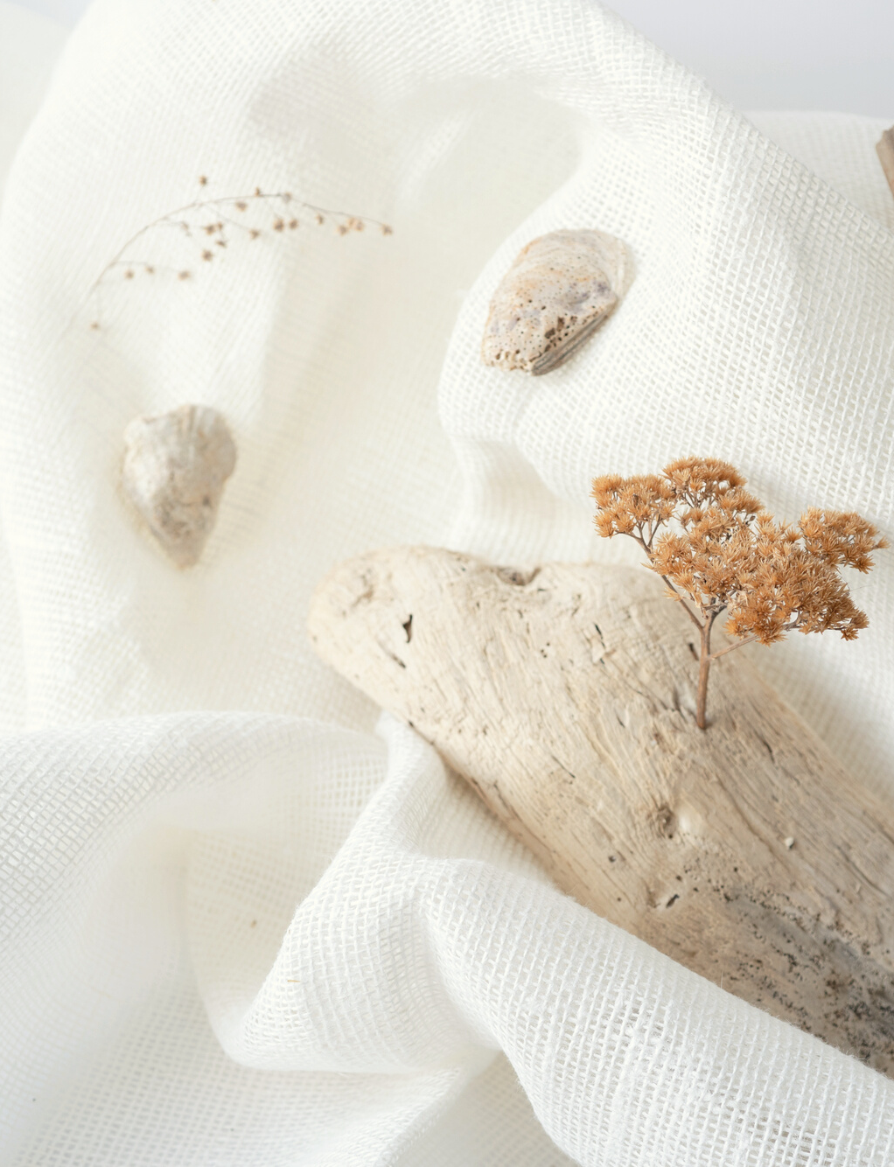
WRITE YOUR TOPIC OR IDEA
Elaborate on what you want to discuss.

Slide 43

WRITE YOUR TOPIC OR IDEA
ADD A MAIN POINT
ADD A MAIN POINT
Elaborate on what you want to discuss.
ADD A MAIN POINT
Elaborate on what you want to discuss.
Elaborate on what you want to discuss.

Slide 44

WRITE YOUR
TOPIC OR IDEA
ADD A MAIN POINT
ADD A MAIN POINT
ADD A MAIN POINT
Elaborate on what you want to discuss.
Elaborate on what you want to discuss.
Elaborate on what you want to discuss.

Slide 45

WRITE YOUR TOPIC OR IDEA
Add a main point Elaborate on what you want to discuss. | Add a main point Elaborate on what you want to discuss. | Add a main point Elaborate on what you want to discuss. .
Add a main point Elaborate on what you want to discuss. | Add a main point Elaborate on what you want to discuss. | Add a main point Elaborate on what you want to discuss.

Slide 46

Write a Heading Here

Slide 47



Write a caption for the photos.

Slide 48


Write an original statement or inspiring quote
— Include a credit, citation, or supporting message

Slide 49




ADD A TEAM MEMBERS PAGE
Elaborate on what you want to discuss.
NAME
NAME
NAME
NAME
Title or Position
Title or Position
Title or Position
Title or Position

Slide 50

WRITE YOUR BIG TOPIC OR IDEA
Elaborate on what you want to discuss.

Slide 51

WRITE YOUR
TOPIC OR IDEA

Slide 52


123,456,789
Elaborate on the featured statistic.

Slide 53

CREDITS
This presentation template is free for everyone to use thanks to the following:
SlidesCarnival for the presentation template
Pexels for the photos
Happy designing!

Slide 54
Misogyny Detection
This presentation template uses the following free fonts:
Titles: Montserrat
Headers: Cabin Regular
Body Copy: Cabin Regular
You can find these fonts online too.
Happy designing!

Slide 55

ADD A TIMELINE PAGE
Add a main point
Add a main point
Add a main point
Add a main point
Elaborate on what you want to discuss.
Elaborate on what you want to discuss.
Elaborate on what you want to discuss.
Elaborate on what you want to discuss.

Slide 56
S
What are you doing well?
What sets you apart?
What are your good qualities?
STRENGTHS
Where do you need to improve?
Are resources adequate?
What do others do better than you?
W
WEAKNESSES
O
What are your goals?
Are demands shifting?
How can it be improved?
OPPORTUNITIES
What are the blockers you're facing?
What are factors outside of your control?
T
THREATS

Slide 57
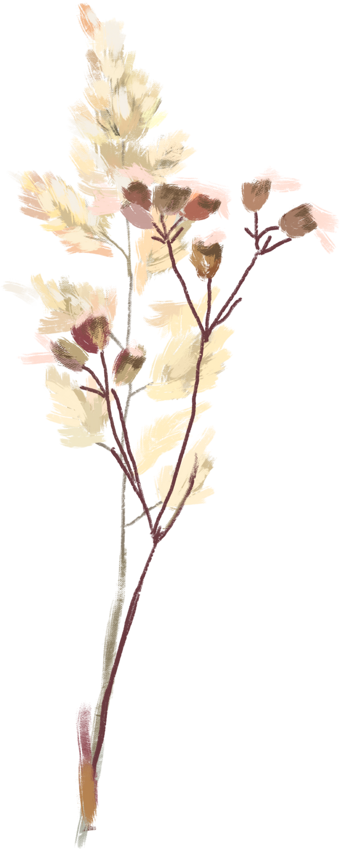
25
20
WRITE YOUR TOPIC OR IDEA
15
10
Elaborate on what you want to discuss.
5
0
Item 1
Item 2
Item 3
Item 4
Item 5

Slide 58

ADD A CHART PAGE
Name
Job Title
Name
Job Title
Name
Job Title
Name
Job Title
Name
Job Title
Name
Job Title
Name
Job Title

Slide 59
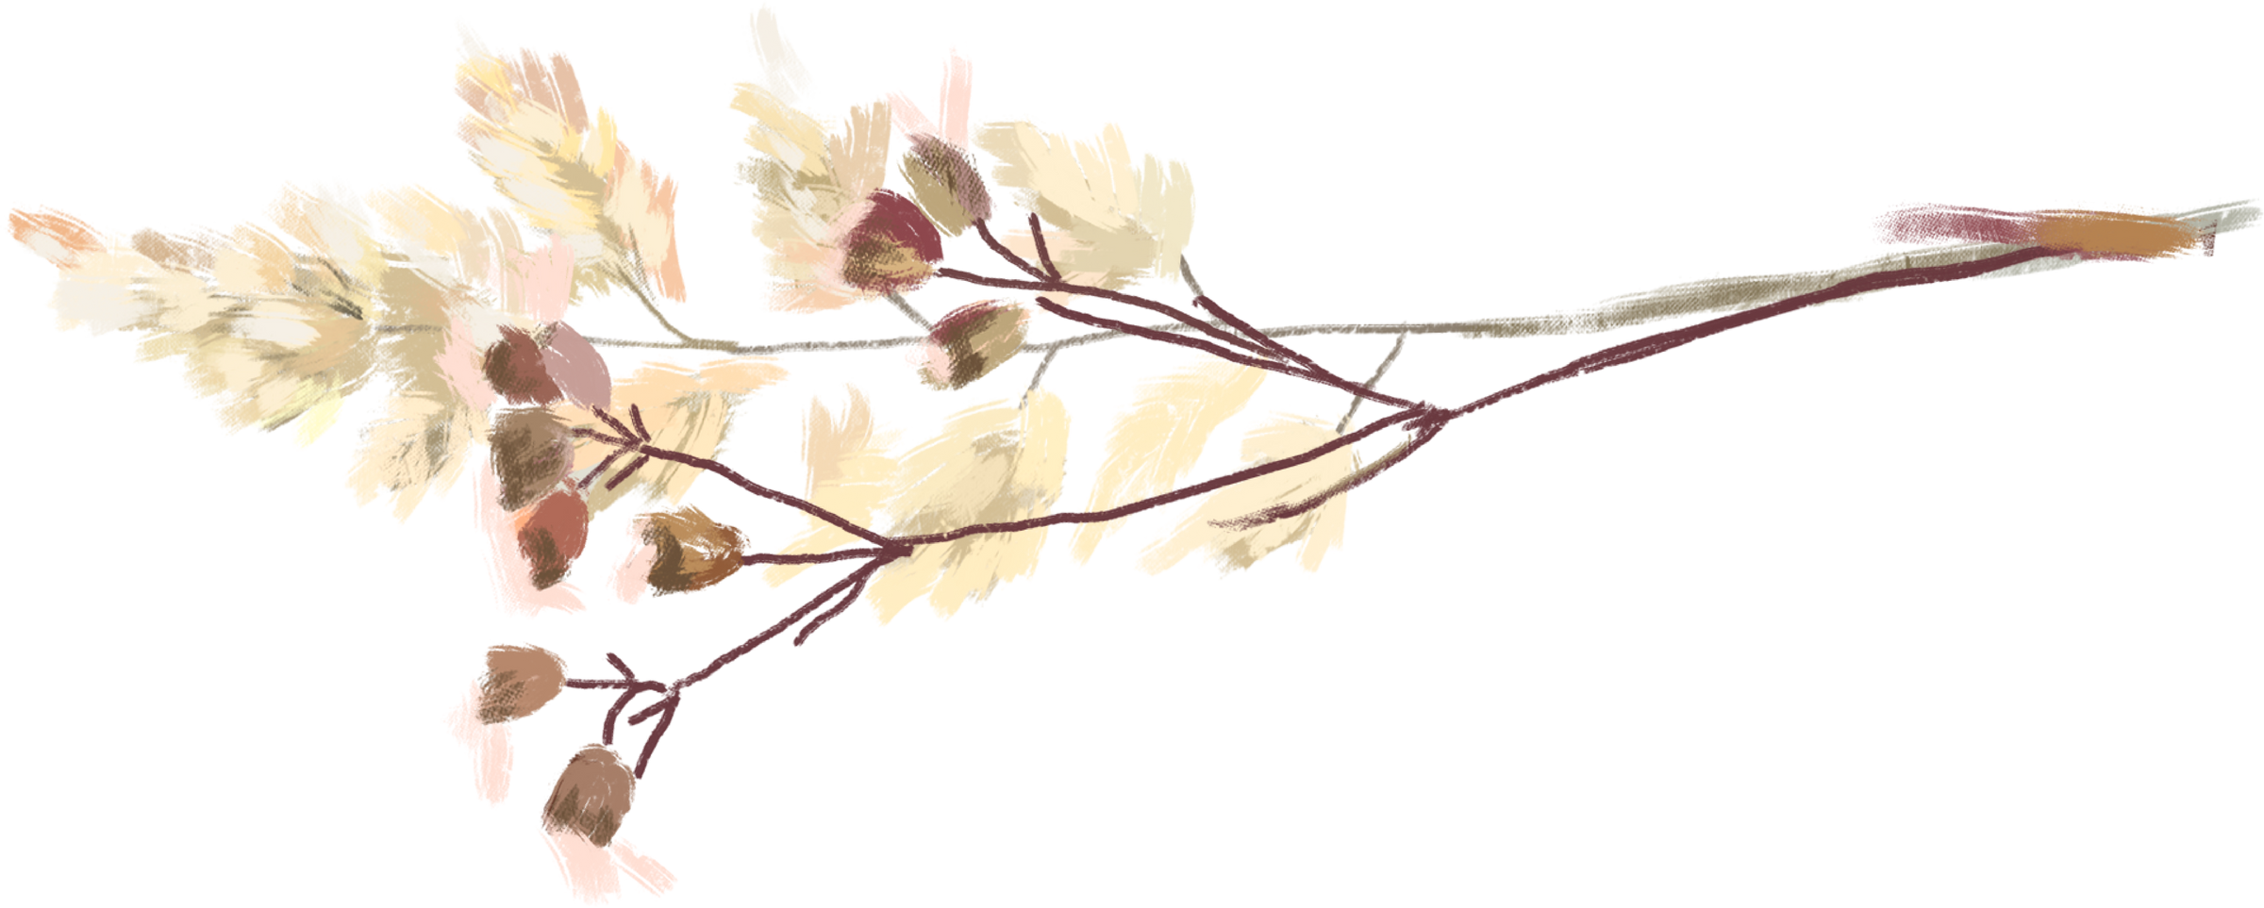
RESOURCE
PAGE
Use these design resources in your Canva Presentation. Happy designing!
Don't forget to delete this page before presenting.

Slide 60




























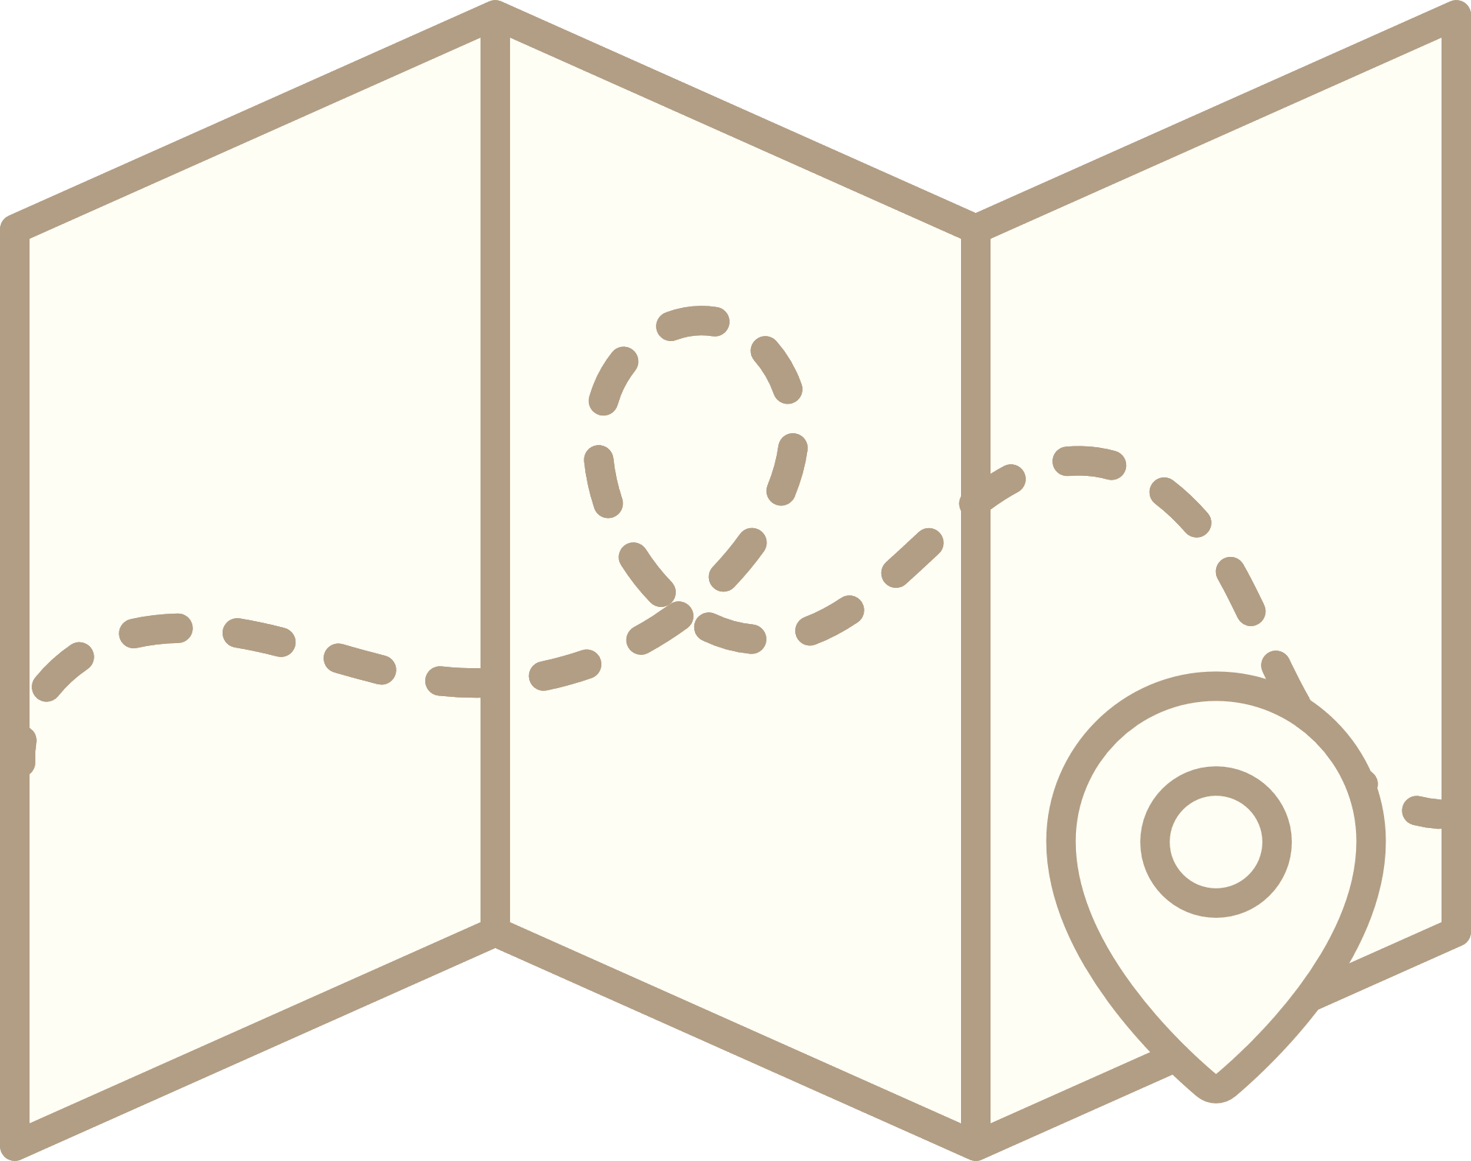




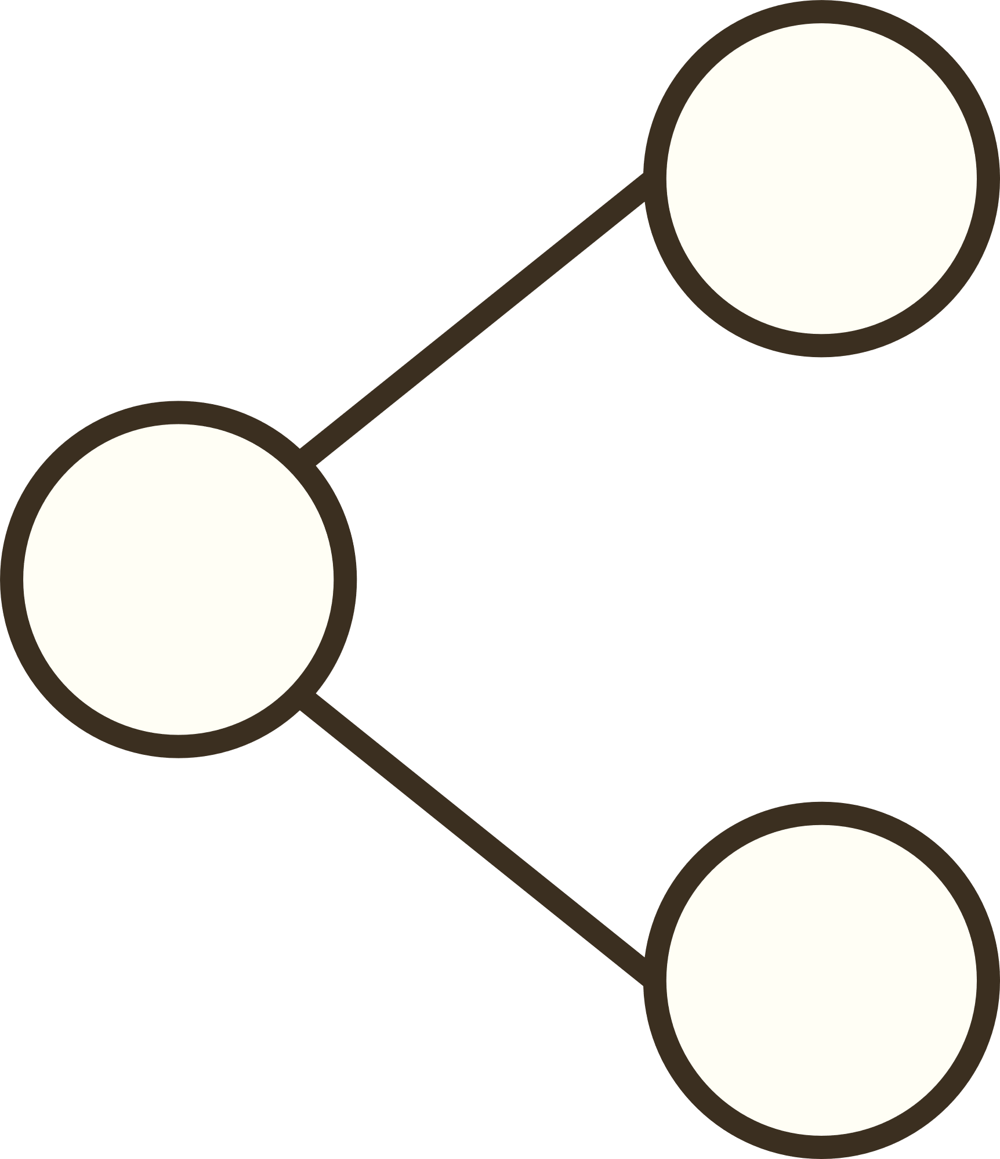





RESOURCE
PAGE
Use these design resources in your Canva Presentation. Happy designing!
Don't forget to delete this page before presenting.

Slide 61

FREE TEMPLATES FOR ALL YOUR PRESENTATION NEEDS
For PowerPoint, Google Slides, and Canva
100% free for personal or commercial use
Ready to use, professional, and customizable
Blow your audience away with attractive visuals

